Slide 1


Slide 2

IDETC Hackathon 2024 Patterns in the Noise: FactoryNet Dataset
Michigan Technological University
Team R2D2

Slide 3
Content Overview
Introduction
Methodology
Implementation
Results & Evaluation
Discussion
Conclusion
Works Cited
Acknowledgements

Slide 4
Content Overview
Introduction
Methodology
Implementation
Results & Evaluation
Discussion
Conclusion
Works Cited
Acknowledgements
Notes:
We will first start with introduction then continue onto our methodology and our contributions to the project.

Slide 5
Introduction

Slide 6
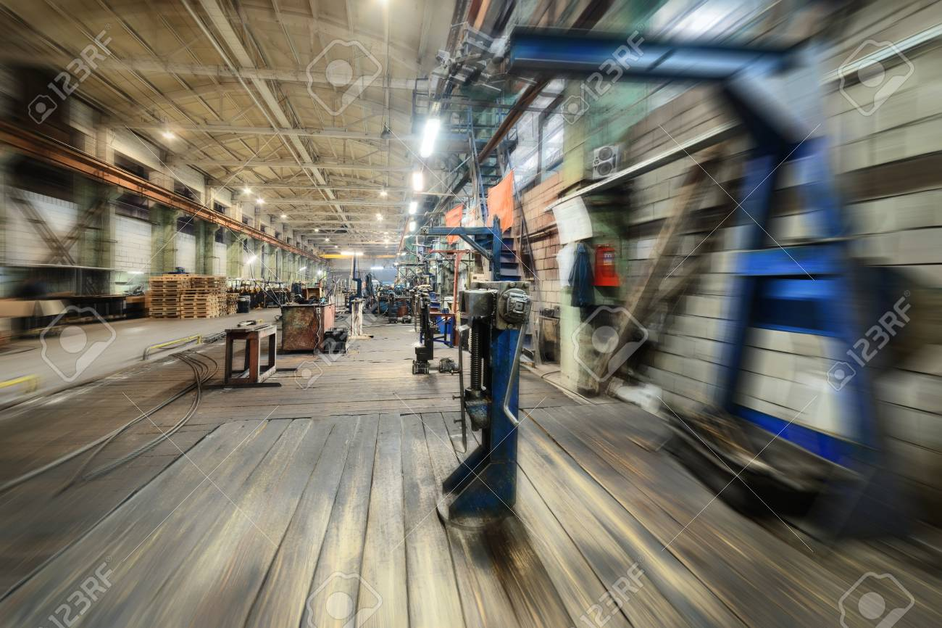
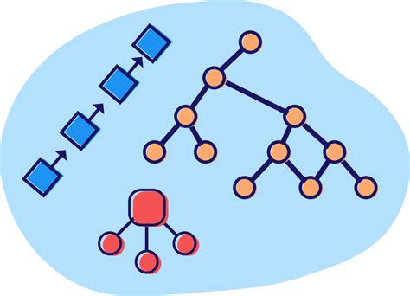
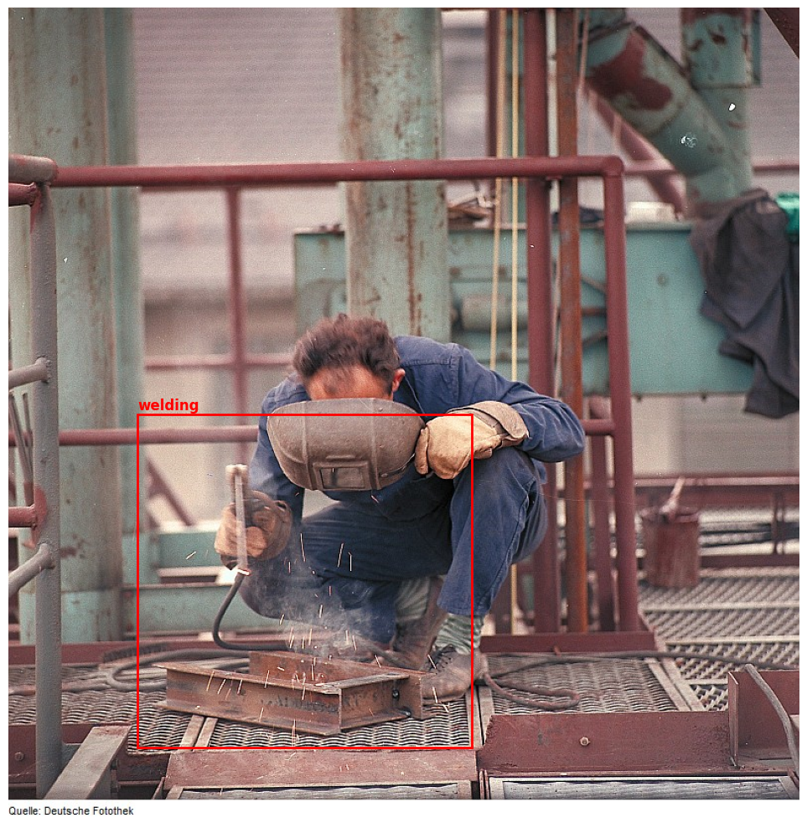
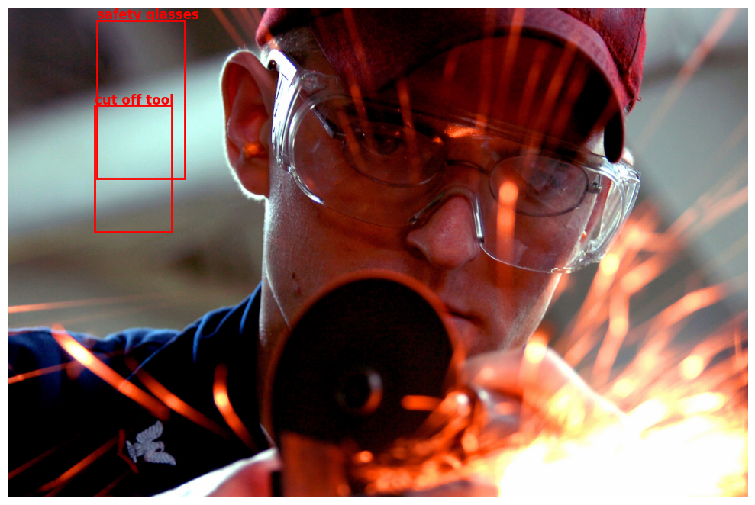
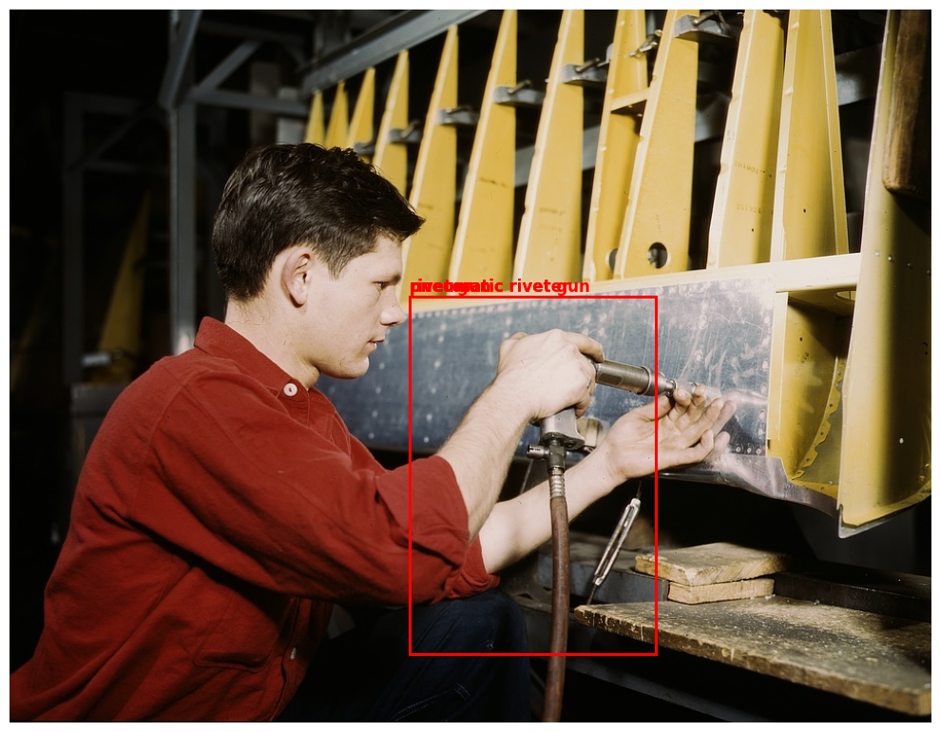
Introduction
https://www.google.com/url?sa=i&url=https%3A%2F%2Fwww.123rf.com%2Fphoto_93863696_factory-shop-abstract-industrial-background-motion-blur-effect.html&psig=AOvVaw12xcVBNSzqfc93HKBmiTLq&ust=1724511228989000&source=images&cd=vfe&opi=89978449&ved=0CBcQjhxqFwoTCKic5Zavi4gDFQAAAAAdAAAAABAE
Low resolution, blurriness, poor lighting conditions, noise or artifacts
Lack of data structure, class imbalance
Overlapping, inaccurate labels
Bounding box placement
Major difference in input consistency impacts AI driven machine vision systems
With over 20,000 images containing redundant, misspelled, or conflicting labels, learning patterns becomes difficult
Structuring, organizing, and sanitizing labels into meaningful classes unlocks the potential of the dataset
Notes:
We started with a dataset of over 20,000 images intended for manufacturing analysis. However, the data is cluttered with redundant, misspelled, and conflicting labels. These inconsistencies (like blurry images, poor resolution and lack of data structure) make it difficult for image classification systems to learn meaningful patterns – which can lead to unreliable outputs. Without proper data structure organization, the models risk overfitting and may learn irrelevant features. To resolve these issues, Tagore will talk more about the strategies.

Slide 7
Methodology

Slide 8
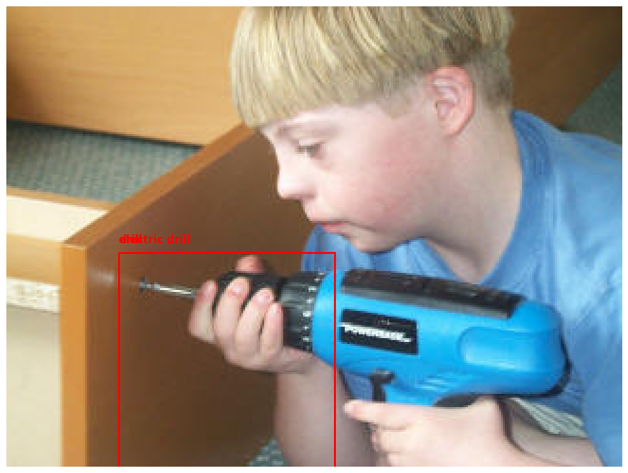
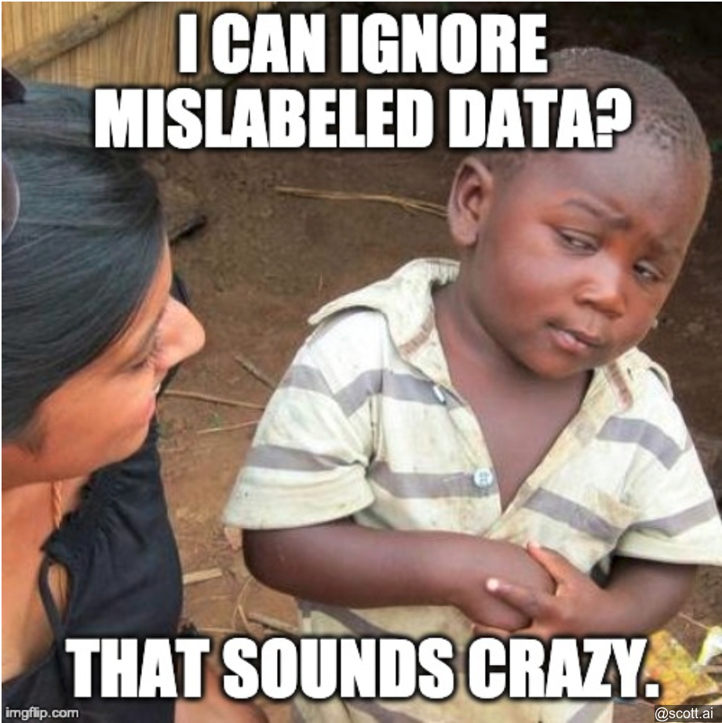
Data Organization Challenge
Unknown Labels (1000+)
"dorfmuseum" "industriedenkmal"
"wehrhahn"
"kailyard“
Organizing labels into balanced group of classes, where terms in classes should have similarities.
A hierarchical labeling structure is needed to ensure classes are mutually exclusive to reduce ambiguity and minimize conflicting labels
Presence of typos, synonyms, and case sensitivity could contribute to the ambiguity and noise in the dataset.
Dropping out bad data is not an option as it would result in remaining 1000-2000 points
Taxonomy Approach
Notes:
From the data, over 1000 labels were unknown, many images had overlapping bounding boxes. We thought it was best to go through this flow chart. The data was cleaned first of typos, spel
With that, we observed that over generalizing classes would reduce model robustness, while having too many classes would cause overlapping. It was clear to us that we needed a well balanced hierarchical labeling structure.
the first two are german, the second is a german company, the last is either scottish for "kitchen garden" or a typo

Slide 9
Data Exploration
Data Cleaning
Lower space
Remove special characters
Data Sanitizing
Spell check library
Inflect library singular form
Data Organization
Clustering labels into unified number of classes
Taxonomy
Output

Slide 10
Data Organization
Lexical Forms
Wordnet
Clustering and Taxonomy
Manufacturing-specific taxonomy can be categorized into labels like “tools”, “processes”, “material”, etc.
Fuzzy matching was used for outliers, defaulted to “equipment” as a fallback
Checks if word directly matches any term in taxonomy
Direct Matching
Fuzzy Match
Find the closest word
FuzzyWuzzy & Gensim
Word Similarity
Calculates cosine similarity
Scipy & Gensim
Checks combination consecutive words
Gensim
Word Combinations
Fallback
Default to “Misc.”
Notes:
Thank you tagore, now we want to map the labels to the taxonomy. We utilized various libraries like wordnet, genism, scipy, and fuzz_match. (explain those)
Wordnet: involves to extraction the lexical structure for the label
gensim: A library for topic modeling and document similarity.
Scipy: calculates the cosine similarity between vectors.
Fuzzy_maching returns the best match if its similarity score exceed a set specified threshold at 0.8.
To map taxonomy, we first check for direct matches with the terms. If no direct match is found, fuzzy matching will try and find the closest term. If fuzzy matching fails, we involve word similarity, which calculates the cosine similarities. Then we use word cominations which checks the combination of consecutive words. And lastly, if that fails, the labels will default to misc.

Slide 11
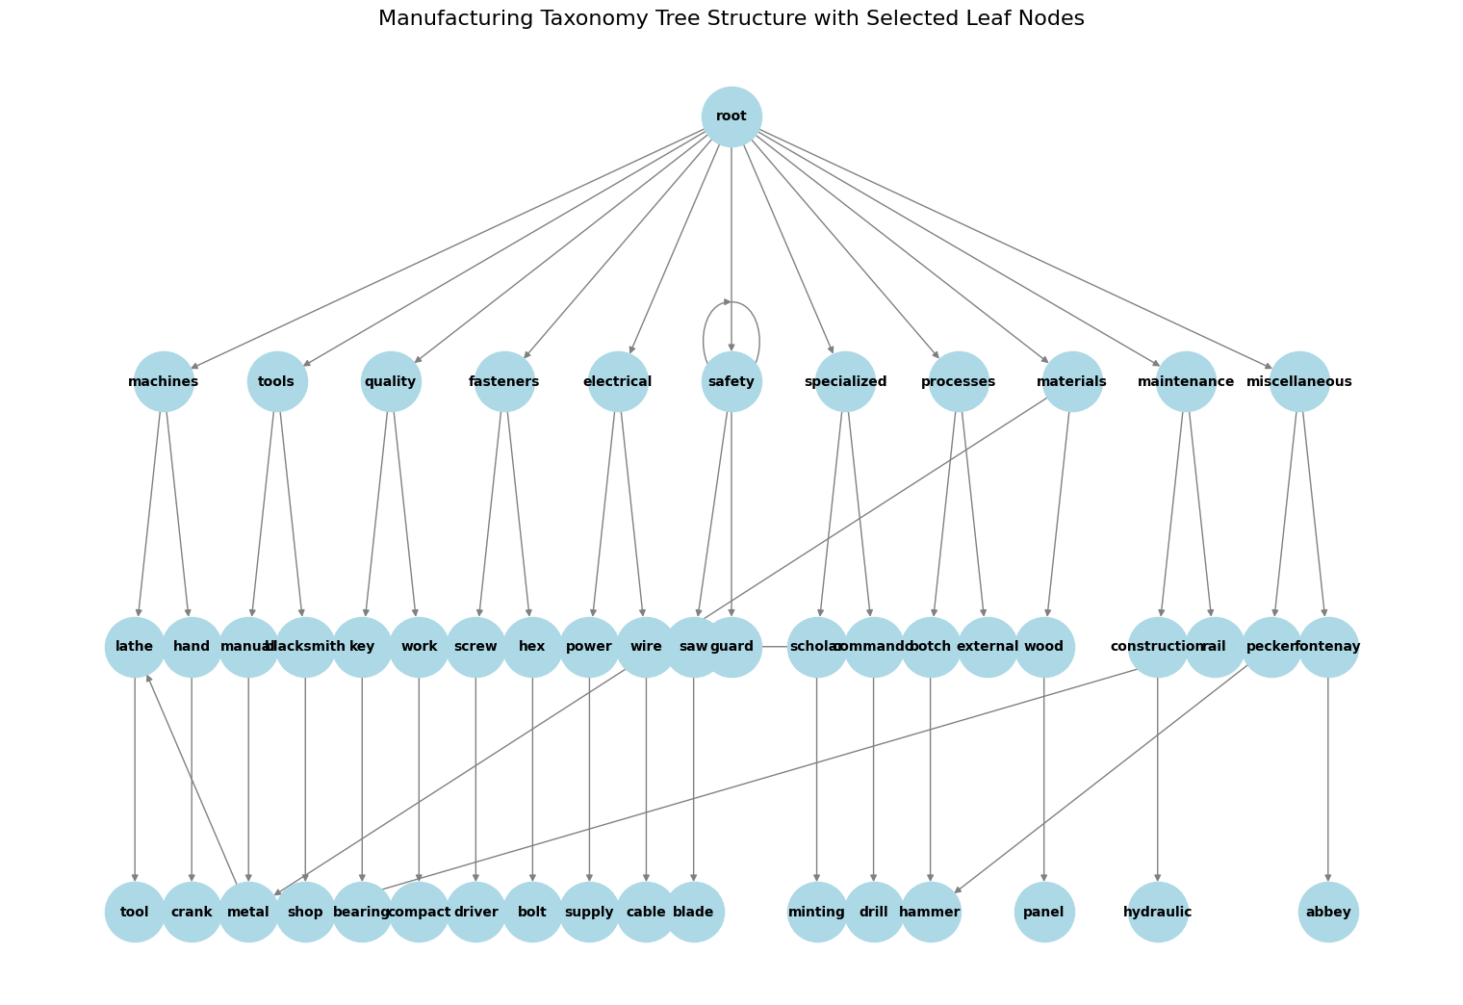
Taxonomy Structure
Notes:
The example image shows a hierarchical taxonomy tree structure where the top node (“root”) represents the broadest category, encompassing all subjects within the given dataset.
The root node branches into 10 selected main categories like machines, tools, quality, fasteners, electrical, safety, specialized, processes, materials, maintenance, and misc. Each primary category branches into more specific subcategories.
After applying a clear taxonomy structure, the next step was to analyze the distribution.

Slide 12
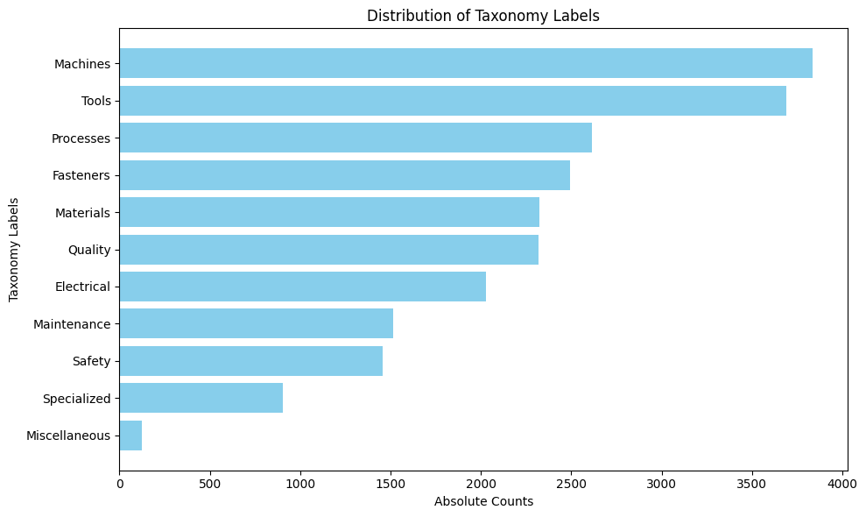
Data Organization Results
Reduced from ~23,000 labels to 10 organized categories
Notes:
As you can see from the bar chart, categories like Machines and Tools contained the highest number of sorted labels. Most labels were concentrated in a few major categories, while Miscellaneous and Specialized had fewer labels. This shows a highly imbalanced class distribution, now we have classification challenge which will be explained by Tagore.

Slide 13
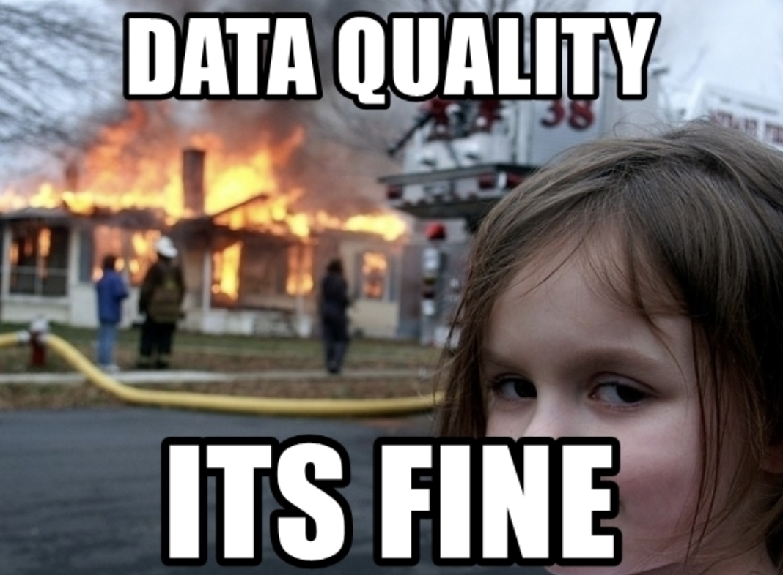
Classification Model Challenge
Overly complex models risk overfitting, while simpler ones may fail to capture class distinctions.
Define meaningful classes
With a limited dataset, overfitting is a major concern.
Notes:
There is no one size fits all approach. Overly complex models risk overfitting, while simpler ones may fail to capture class distinctions. There must be a careful selection of models that strike the balance in flexibility and specificity.
The classes must be statistically significant and relevant to real-world applications while avoiding similar classes and maintaining meaningful distinctions.
With a limited dataset, overfitting is a major concern.
Resnet152 vs Resnet18

Slide 14
Classification, Training, Validation Strategy
Model Choice
ResNet152 was selected for its state-of-the-art performance in vision tasks
Concerned with overfitting shifted to simpler models
The effectiveness relied on meaningful distinctions
Data Splitting
Training 60%
Resnet152 vs Resnet 50 vs Resnet18
Validation 20%
Testing 20%
Stratified sampling
Notes:
Model Choice: ResNet152 was selected for its state-of-the-art performance in challenging tasks. Concerns of overfitting due to a small dataset shifted focus to simpler models.Class Distinctions: The effectiveness relied on meaningful class distinctions.Augmentation and Cross-Validation: Class imbalance was addressed using augmentation strategies and cross-validation. Hyperparameters were tuned iteratively with continuous evaluation to ensure generalization across classes without sacrificing accuracy.

Slide 15
Address class imbalance
Majority Class
Standard Augmentation – resizing, random flips, rotations, color adjustments, and normalization
Minority Class
Aggressive Augmentation – random affine, random prospection
Mix-Up Sampling – variability, model learning smoother decision boundaries
Focal Loss – gamma, alpha, high weights for hard-to-classify ones
New Custom Dataset

Slide 16
Implementation

Slide 17

Computing Resources
PyTorch framework
System equipped with two RTX 3090 GPUs (24 GiB VRAM) and 128 GB of RAM

Slide 18
Results & Evaluation

Slide 19
Classification Model Results
The model achieved best performance with a learning rate of 0.01 and a batch size of 128 – determined through cross validation
Resnet18: 40%
Resnet50: 42%
Resnet152: 45%
Notes:
We tuned the hypermeters iteratively, then retrained model using those hyperparmeters.
As cited in the resnet paper, increasing model size increases accuracy.
We first tried resnet18

Slide 20
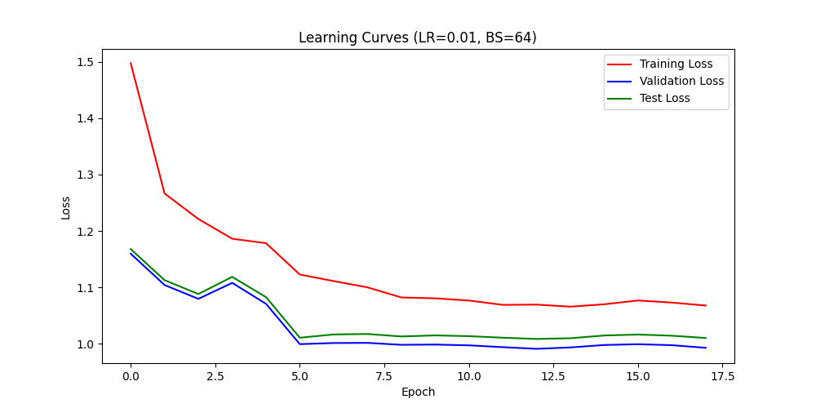
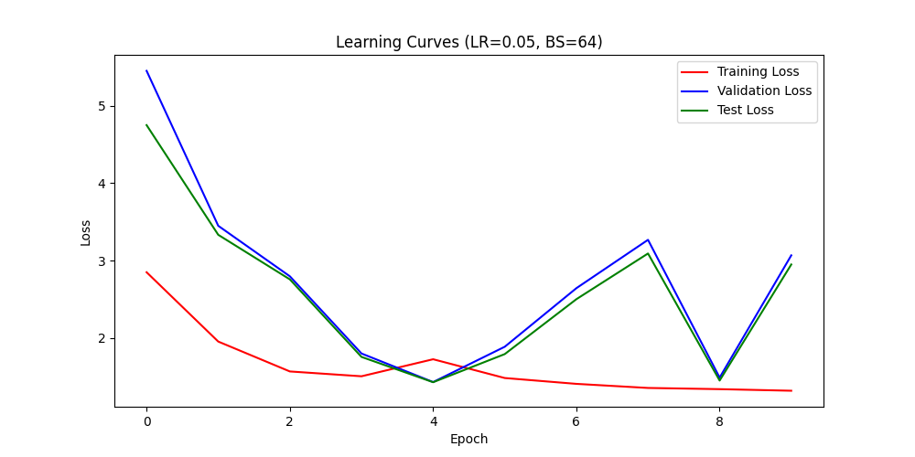
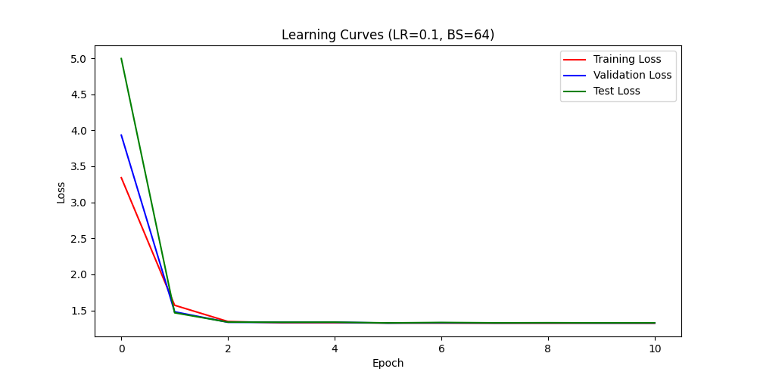
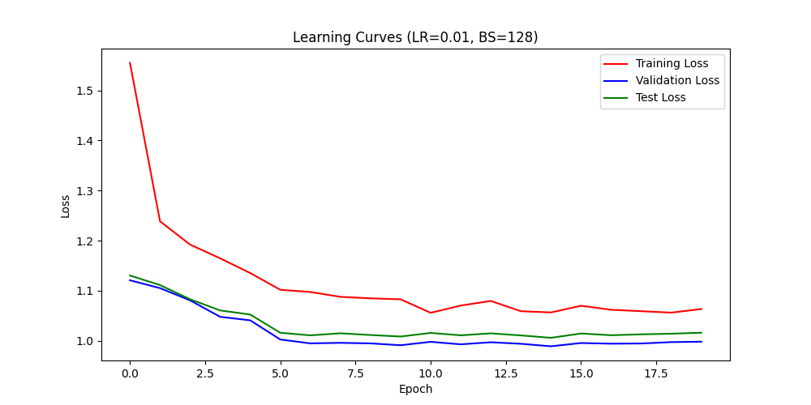
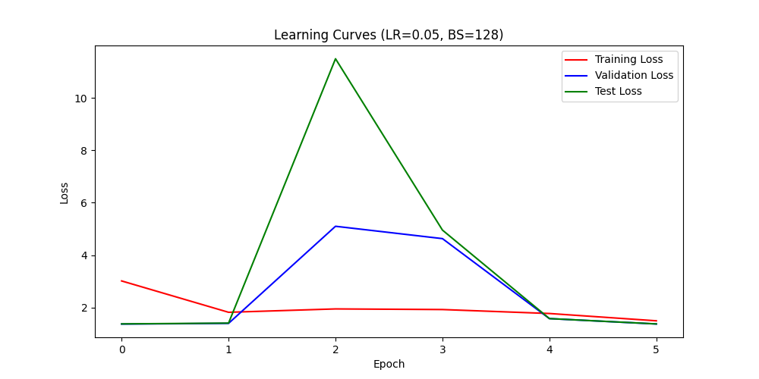
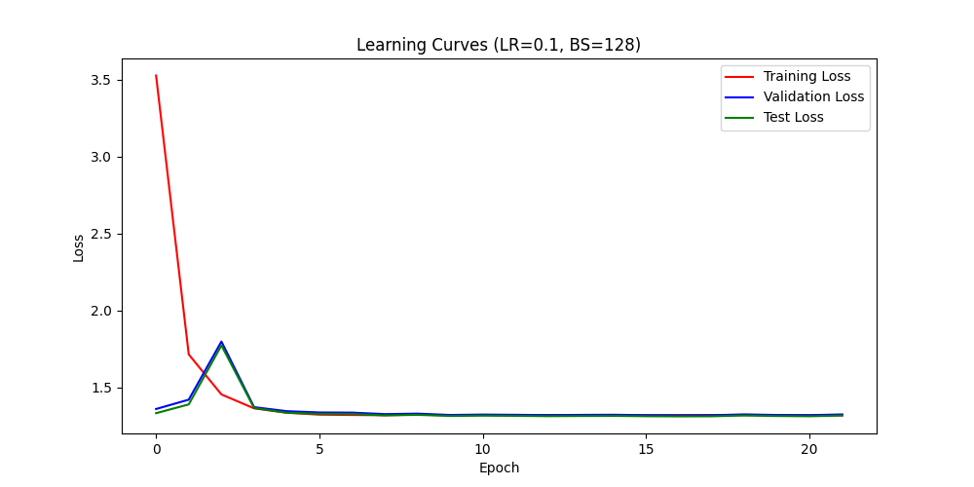
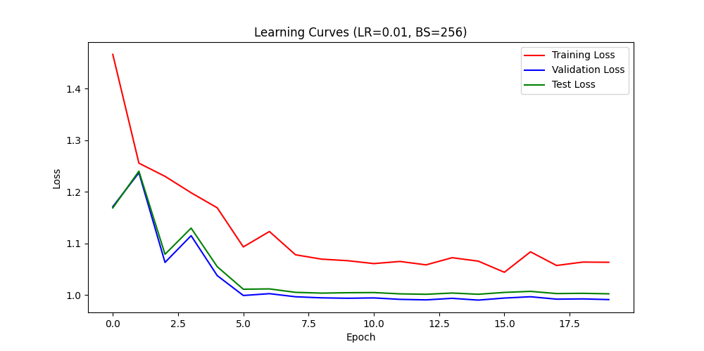
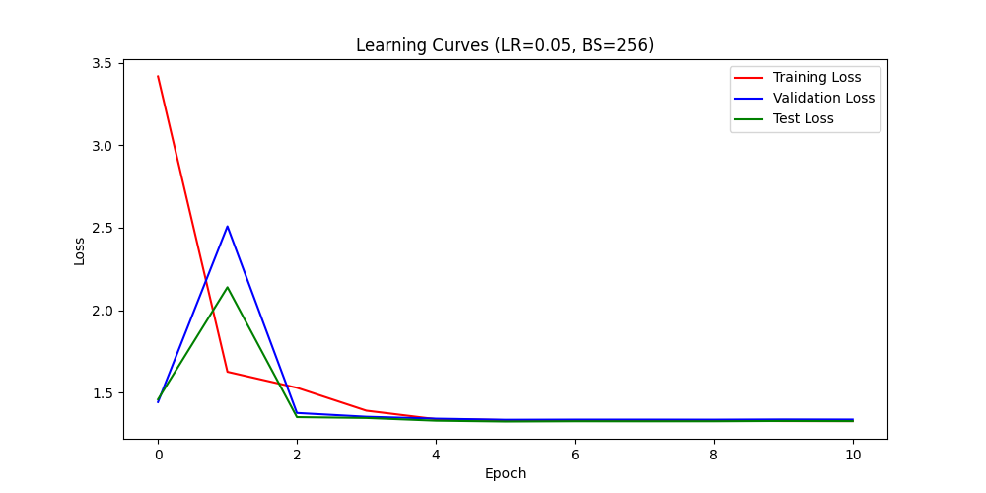
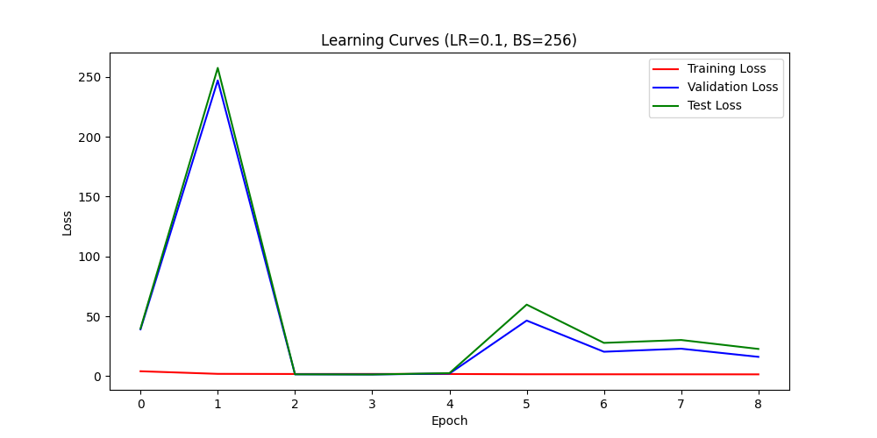
Notes:
Point at the most optimal. Tagore will talk about the confusion matrices.

Slide 21
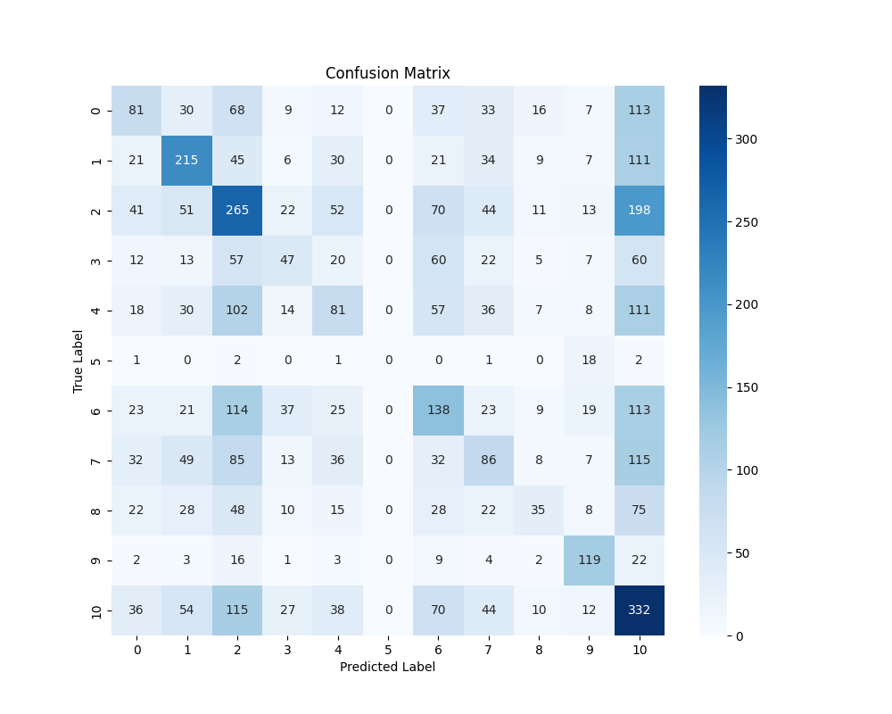
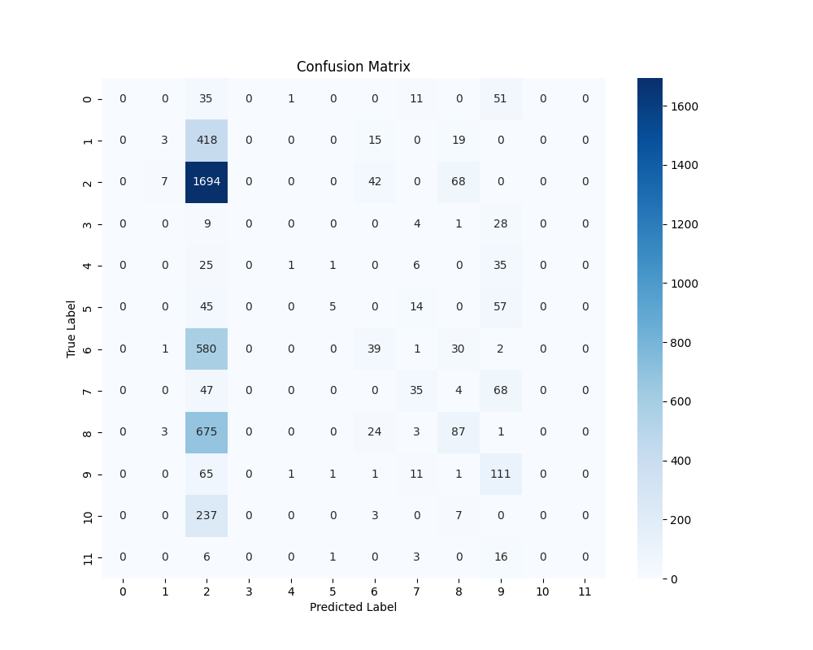
Comparative Analysis
Random class labels approach
Taxonomy based sorting

Slide 22
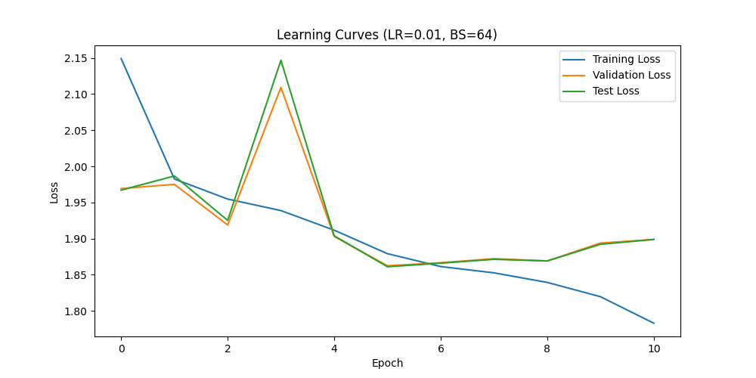
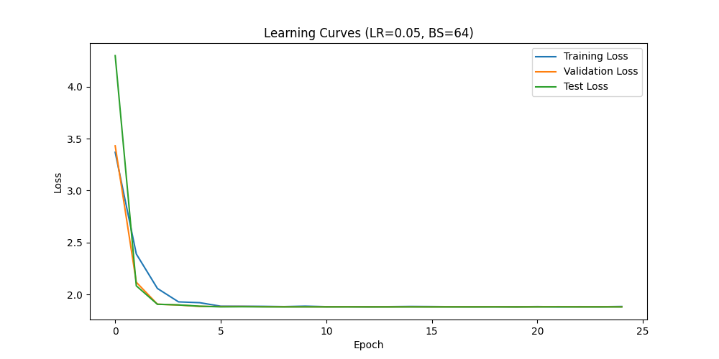
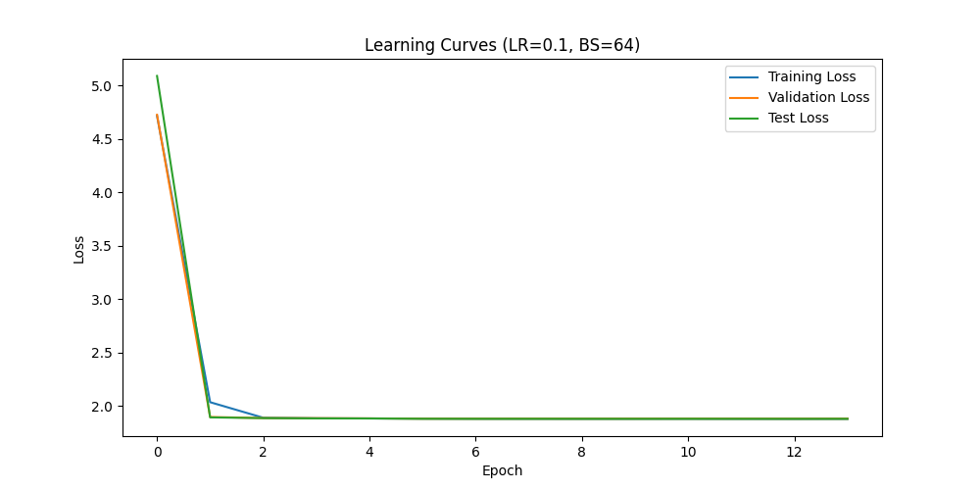
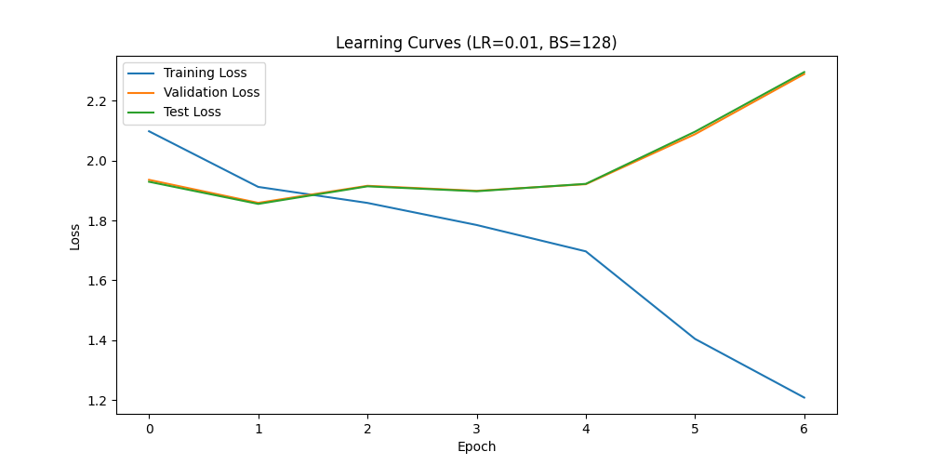
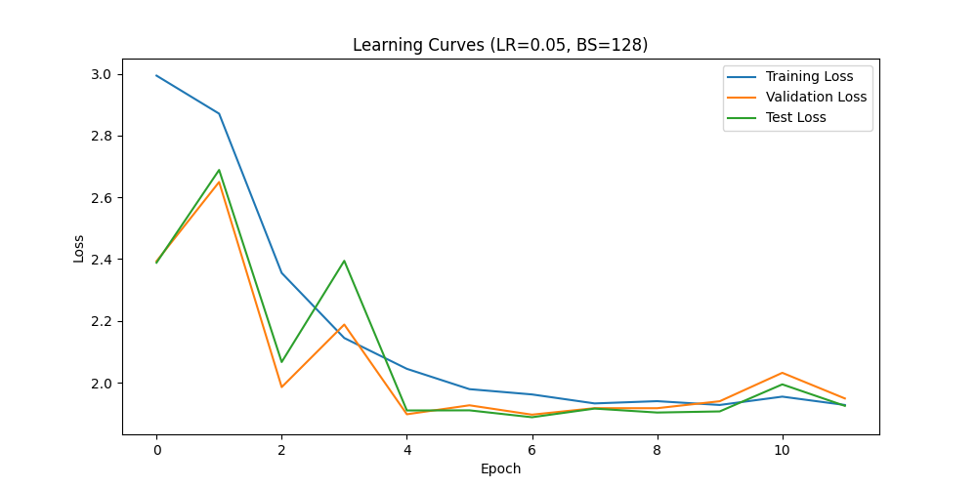
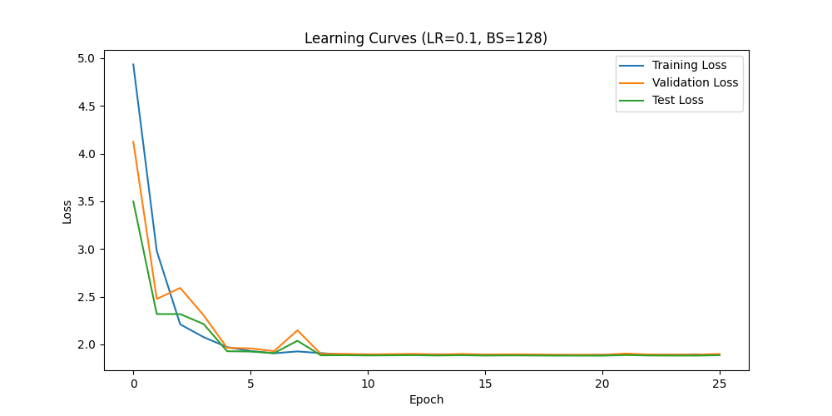
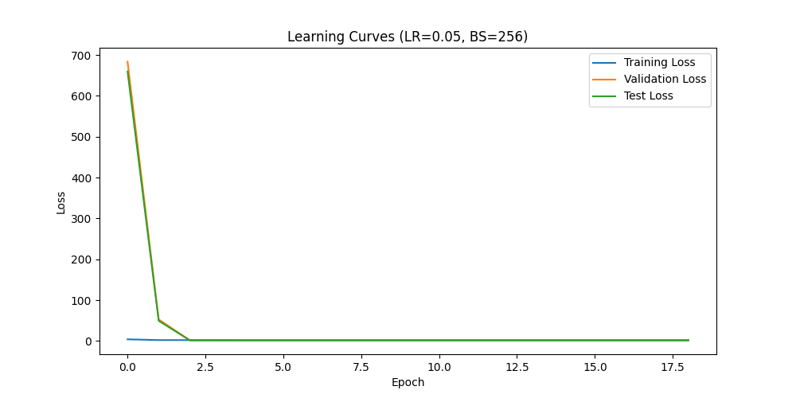
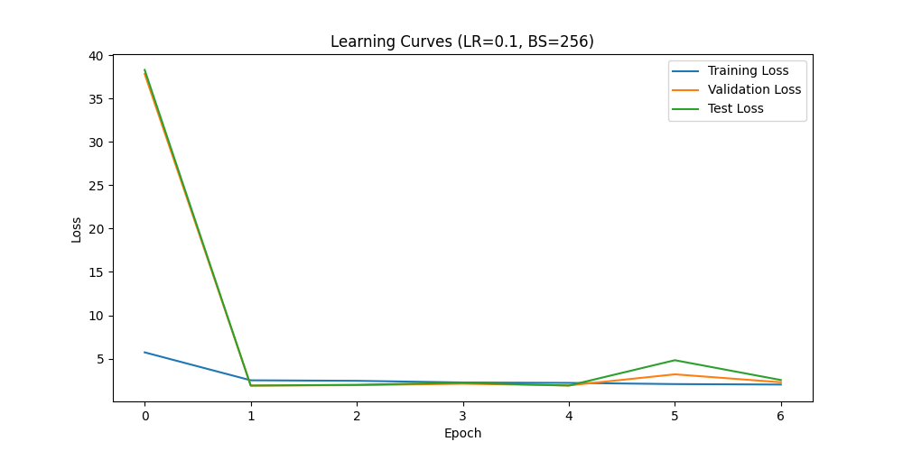
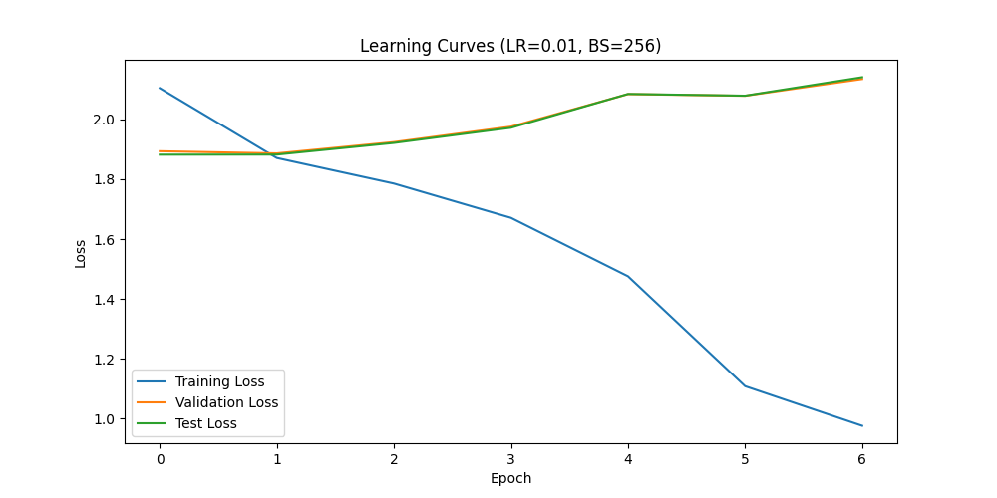

Slide 23
Discussion

Slide 24
Other Methods Explored
Hierarchical Clustering
Community Clustering
Sampling Techniques
Resulting clusters too granular/broad
Struggled with high dimensionality and ambiguity of the labels, clusters were either irrelevant or disconnected
Oversampling
Under sampling
Notes:
Hierarchical Clustering
Resulting clusters too granular/broad
Community Clustering
Struggled with high dimensionality and ambiguity of the labels, clusters were either irrelevant or disconnected
Radom Sample Down sampling
Down sampling introduced noise and discarded important data

Slide 25
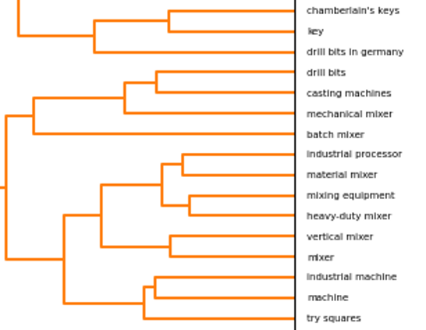
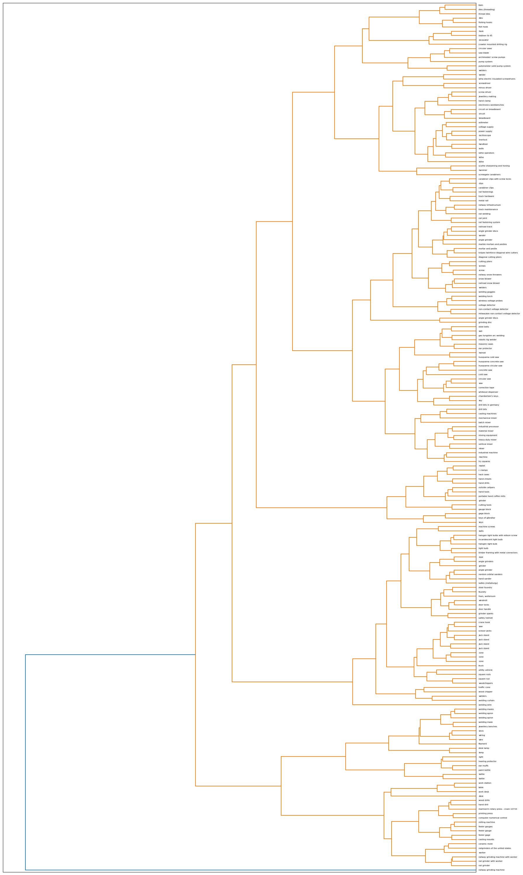
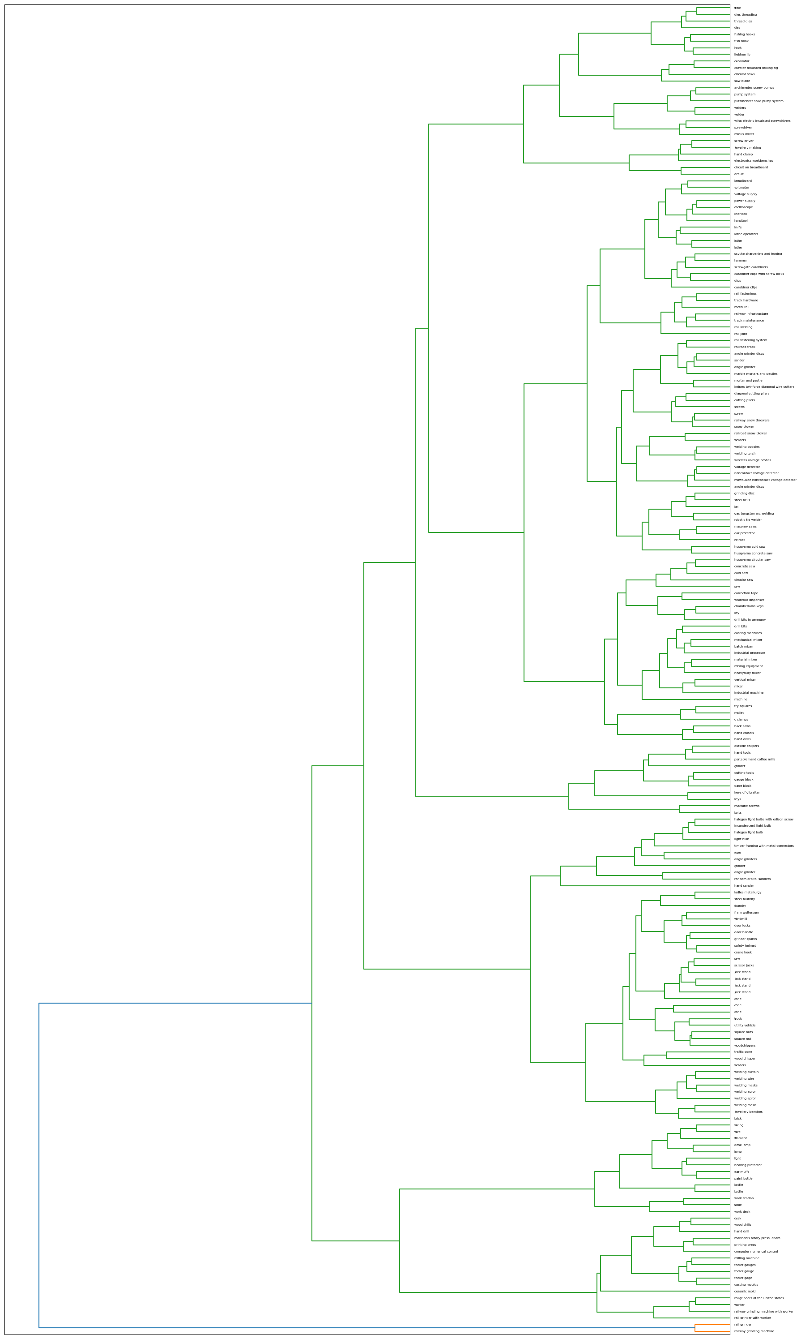
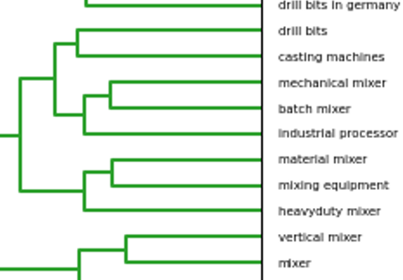
Hierarchical Clustering

Slide 26
Methodology Explored
Hierarchical Clustering
Community Clustering
Sampling Techniques
Resulting clusters too granular/broad
Struggled with high dimensionality and ambiguity of the labels, clusters were either irrelevant or disconnected
Oversampling
Under sampling
Notes:
Hierarchical Clustering
Resulting clusters too granular/broad
Community Clustering
Struggled with high dimensionality and ambiguity of the labels, clusters were either irrelevant or disconnected
Radom Sample Down sampling
Down sampling introduced noise and discarded important data

Slide 27
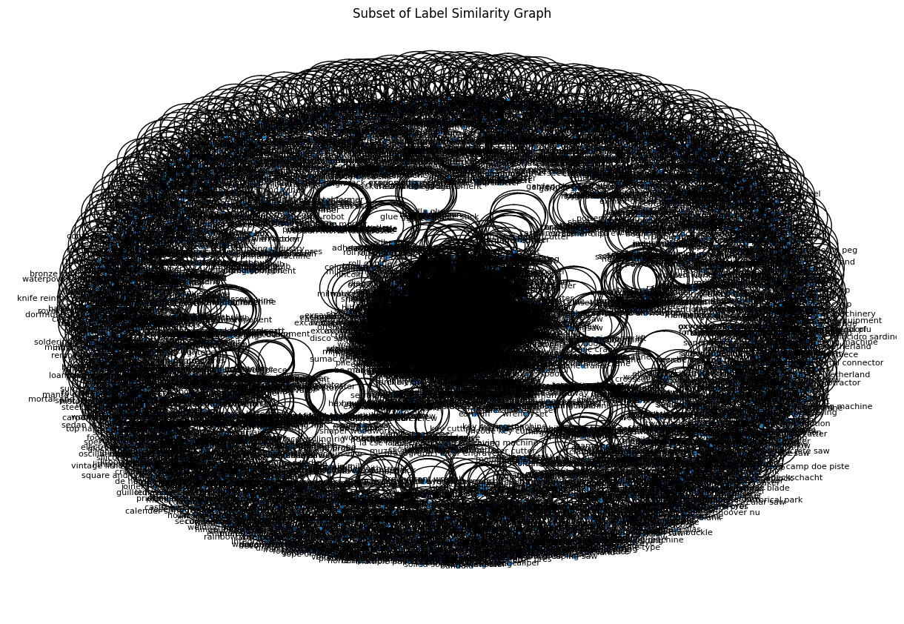
Community Clustering
Community 1: ['worker', 'construction work', 'construction', 'factory worker', 'construction worker']
Community 5: ['worker with milling machine', 'milling bit', 'milling machine shop', 'electrical machining tool', 'milling machine rotary table', 'taxi milling machine’, etc.]
Community 1270: ['wire bending hand tool', 'sheet metal bending machine', 'plate bending machine', 'schmalz speedway wire bending machine', 'bending machine', 'wire bending machine’]
Community 1303: ['wall hook', 'towheaded industrial hook', 'coat hook', 'fishing hook', 'hand hook', 'towheaded hook', 'hook hand tool', 'boat hook', 'fish hook with bait', 'industrial hook', 'fish hook’]

Slide 28
Methodology Explored
Hierarchical Clustering
Community Clustering
Sampling Techniques
Resulting clusters too granular/broad
Struggled with high dimensionality and ambiguity of the labels, clusters were either irrelevant or disconnected
Oversampling
Under sampling
Notes:
Hierarchical Clustering
Resulting clusters too granular/broad
Community Clustering
Struggled with high dimensionality and ambiguity of the labels, clusters were either irrelevant or disconnected
Radom Sample Down sampling
Down sampling introduced noise and discarded important data

Slide 29
Hierarchical Clustering Top Approach
Root
0
2
3
1
4
5
11
10
7
6
12
16
15
17
13
14
8
9

Slide 30
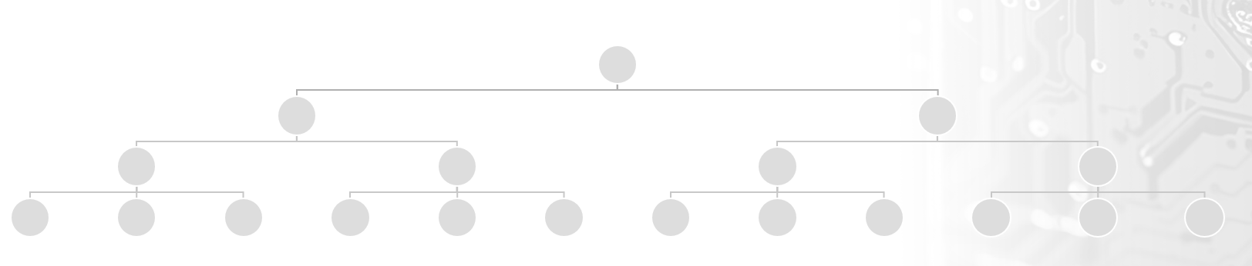
Hierarchical Clustering Bottom Approach

Slide 31
Obstacles Faced
Data Organization:
Classification Model:
Label inconsistency
Dealing with inconsistent labels, typos and redundant terms (e.g., “industry monument” vs “IndustrieDenkmal”)
Resolved with fuzzy matching, hierarchical clustering, and a manual curation to consolidate synonymous terms into meaningful categories
Bounding box inconsistency
Class imbalance
Severe class imbalance required creative solutions without introducing too much noise
Integration of custom dataset class
Weighted cross-entropy loss and custom focal loss function were implemented to counter class imbalance
Mixed sampling
Implemented step scheduler and early stopping mechanism to prevent overfitting
Constraints on limited time

Slide 32
Conclusion

Slide 33
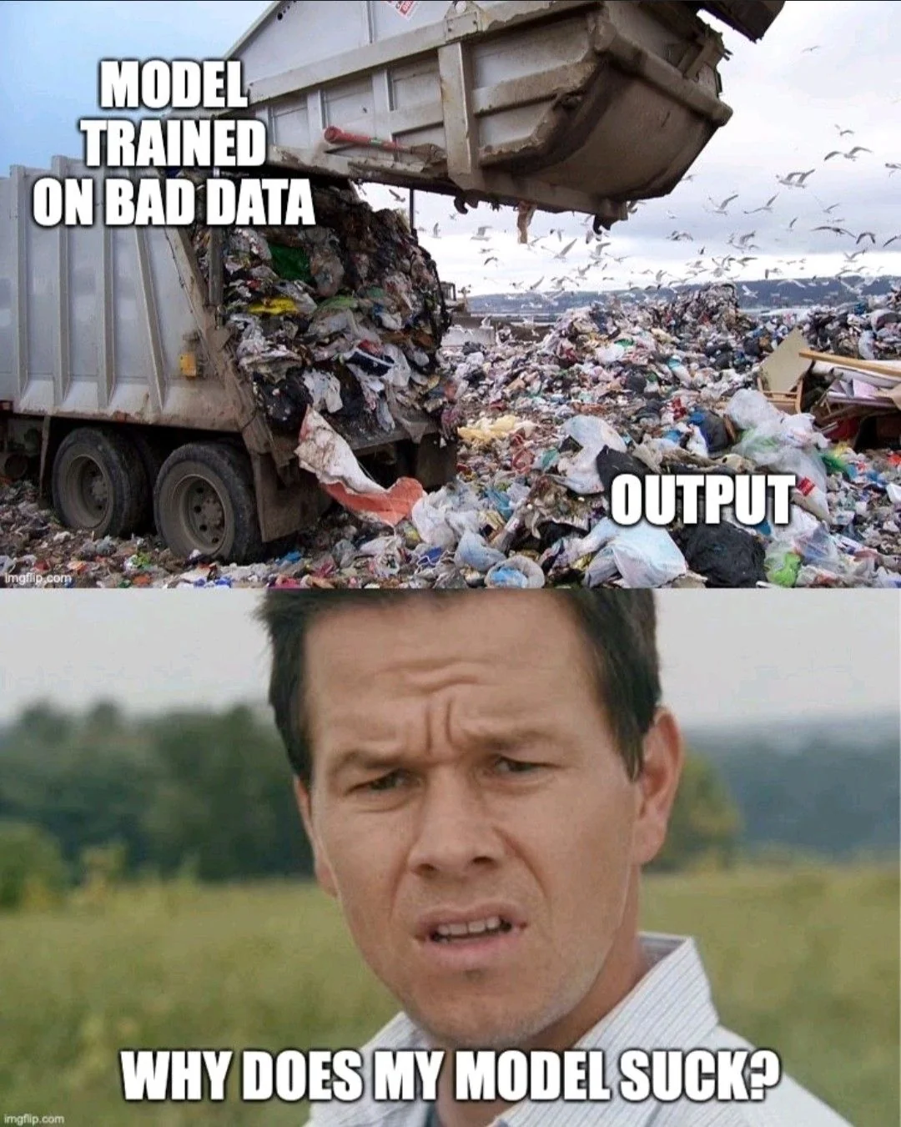
Conclusion
The project resulted in a refined and structured hierarchical dataset with 10 classes
Combining targeted data cleaning with tailored model design is an approach for handling imbalanced and noisy datasets
Further exploration could include integrating more advanced augmentation techniques or experimenting alternative models

Slide 34
Future Work
Clip model, general adversarial networks, transformers
Refine taxonomy approach
Bounding box (bbox) issues, extract the correct bbox area
Explore TensorFlow libraries for image processing

Slide 35
Code and Reproducibility
The entire codebase is uploaded onto this GitHub Repo.

Slide 36
Acknowledgements
We would like to thank Dr. Vinh Nguyen and Dr. Evan Lucas for their support and dedication. We would also like to thank the Center of AI at Michigan Technological University for this opportunity.

Slide 37
Works Cited
[1] L. Nagy, T. Ruppert, and János Abonyi, “Ontology-Based Analysis of Manufacturing Processes: Lessons Learned from the Case Study of Wire Harness Production,” Complexity, vol. 2021, pp. 1–21, Nov. 2021, doi: https://doi.org/10.1155/2021/8603515.
[2] F. Murtagh and P. Legendre, “Ward’s Hierarchical Agglomerative Clustering Method: Which Algorithms Implement Ward’s Criterion?,” Journal of Classification, vol. 31, no. 3, pp. 274–295, Oct. 2014, doi: https://doi.org/10.1007/s00357-014-9161-z.
[3] “Hierarchical clustering: structured vs unstructured ward,” scikit-learn, 2024. https://scikit-learn.org/stable/auto_examples/cluster/plot_ward_structured_vs_unstructured.html (accessed Aug. 23, 2024).
[4] “Google Colab,” Google.com, 2019. https://colab.research.google.com/github/dipanjanS/nlp_workshop_odsc19/blob/master/Module05%20-%20NLP%20Applications/Project02%20-%20Text_Clustering.ipynb#scrollTo=praegyPtQ6Xk (accessed Aug. 23, 2024).
[5] S. Targ, D. Almeida, and K. Lyman, “Resnet in Resnet: Generalizing Residual Architectures,” arXiv:1603.08029 [cs, stat], Mar. 2016, Available: https://arxiv.org/abs/1603.08029
[6] F. He, T. Liu, and D. Tao, “Why ResNet Works? Residuals Generalize,” IEEE Transactions on Neural Networks and Learning Systems, pp. 1–14, 2020, doi: https://doi.org/10.1109/tnnls.2020.2966319.
[7] C. Szegedy, S. Ioffe, V. Vanhoucke, and A. Alemi, “Inception-v4, Inception-ResNet and the Impact of Residual Connections on Learning,” Proceedings of the AAAI Conference on Artificial Intelligence, vol. 31, no. 1, Feb. 2017, Available: https://ojs.aaai.org/index.php/AAAI/article/view/11231
[8] X. Li, Y. Wang, Z. Sha, “Deep Learning of Cross-Modal Tasks for Conceptual Design of Engineered Products: A Review,” ASME 2022 International Design Engineering Technical Conferences & Computers and Information in Engineering Conference, St. Louis, Missouri, Aug. 14-17, 2022.
Notes:
An at this time, we would like to open up the floor for any questions. Thank you.
With that, that concludes our presentation. Thank you everyone for your time and attention.

